Slide 1



Customer Segmentation Using K- means
Project By
Nishad Chaoji
College – MIT , Manipal

Slide 2
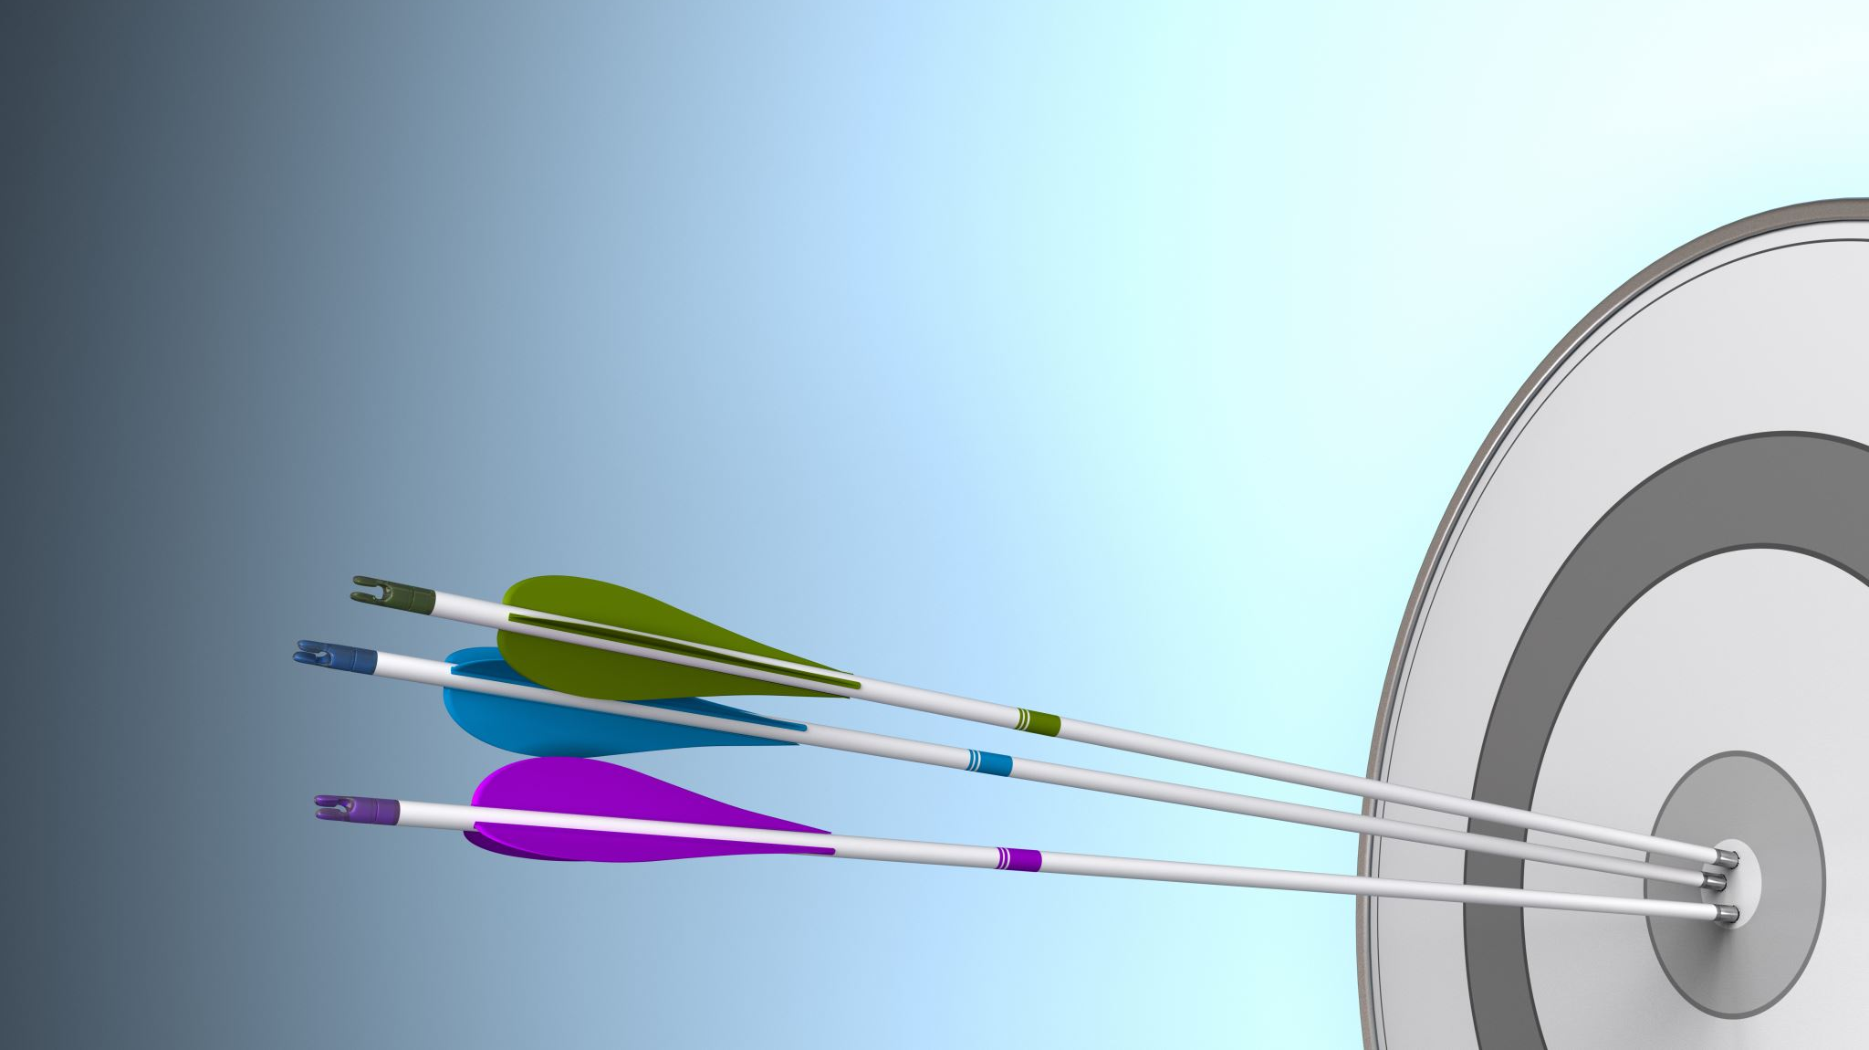
What is Customer Segmentation?
z

Slide 3
Customer segmentation is the practice of dividing a company's customers into groups that reflect similarity among customers in each group. The goal of segmenting customers is to decide how to relate to customers in each segment in order to maximize the value of each customer to the business.

Slide 4
Why do we need Customer Segmentation

Slide 5
While mass marketing tactics are still able to get results, the assumption that simply everyone will be interested in buying what you are selling is a time-consuming, inefficient and expensive strategy.
Instead of a ‘one-size-fits-all’ approach, successful segmentation clusters your customer data into groups sharing the same properties or behavioral characteristics, helping to drive dynamic content and personalization tactics for timelier, relevant and more effective marketing communications.

Slide 6
Segmentation Factors
There are 4 major segmentation factors that influence the segments:
Demographic
Psychographic
Behavioral
Geographic

Slide 7
Demographic Factors
Demographic segmentation groups customers and potential customers together by focusing on certain traits such as age, gender, income, occupation & family status.

Slide 8
Psychographic Factors
Psychographic segmentation is a marketing strategy that leverages customer data and with a foundation in psychology uses data to create customer segments based on psychological characteristics like interests, lifestyle, priorities, motivations

Slide 9
Behavioral Factors
Behavioral segmentation refers to a process in marketing that divides customers into segments depending on their behavior patterns when interacting with a particular business or website. These include the purchasing habits, spending habits, user status, brand interaction etc.

Slide 10
Geographic Factors
Geographic segmentation involves segmenting your audience based on the region they live or work in. This can be done in any number of ways: grouping customers by the country they live in, or smaller geographical divisions, from region to city, and right down to postal code.

Slide 11
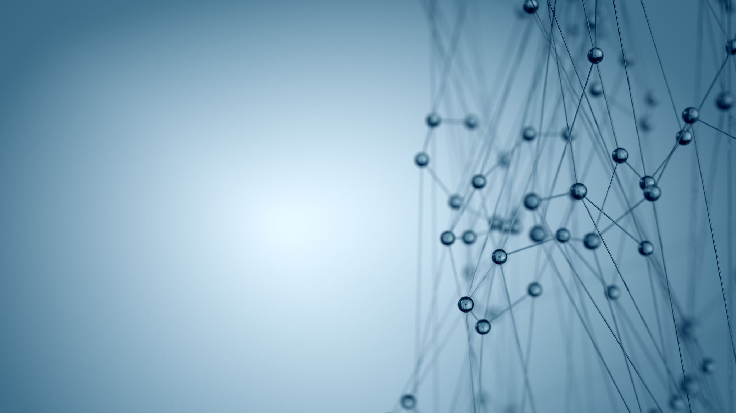
Clustering Algorithm

Slide 12
What is Clustering ?
Clustering, is an unsupervised machine learning task. It involves automatically discovering natural grouping in data. Unlike supervised learning (like predictive modeling), clustering algorithms only interpret the input data and find natural groups or clusters in feature space.

Slide 13
Types of Clustering Algorithms
There are 4 major types of clustering Algorithms
Centroid Based clustering
Centroid-based clustering organizes the data into non-hierarchical clusters
Density based clustering
Density-based clustering connects areas of high example density into clusters.

Slide 14
Types of Clustering Algorithms
Distribution based Clustering
This clustering approach assumes data is composed of distributions, such as Gaussian Distribution
Hierarchical based Clustering
Hierarchical clustering creates a tree of clusters. Hierarchical clustering, not surprisingly, is well suited to hierarchical data, such as taxonomies.

Slide 15

K-means Algorithm

Slide 16
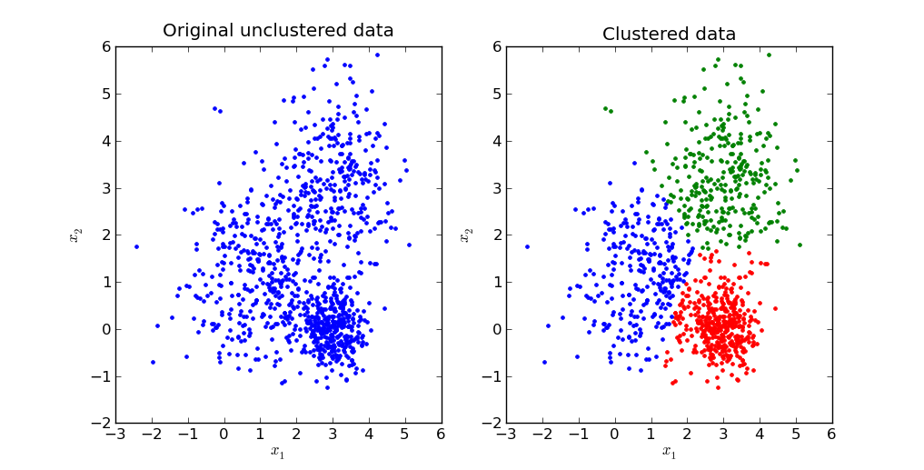
K-means is a centroid-based algorithm, or a distance-based algorithm, where we calculate the distances to assign a point to a cluster. In K-Means, each cluster is associated with a centroid.
z
This Photo by Unknown author is licensed under CC BY-SA.

Slide 17
Benefits of Clustering using K means
If variables are huge, then K-Means most of the times computationally faster than hierarchical clustering, if we keep k smalls.
K-Means produce tighter clusters than hierarchical clustering, especially if the clusters are globular.

Slide 18
Implementing K – means Clustering Using Python
The working of the K-Means algorithm is explained in the below steps:
Step-1: Select the value of K, to decide the number of clusters to be formed.
Step-2: Select random K points which will act as centroids.
Step-3: Assign each data point, based on their distance from the randomly selected points (Centroid), to the nearest/closest centroid which will form the predefined clusters.

Slide 19
Implementing K – means Clustering Using Python
Step-4: place a new centroid of each cluster.
Step-5: Repeat step no.3, which reassign each datapoint to the new closest centroid of each cluster.
Step-6: If any reassignment occurs, then go to step-4 else go to Step 7.
Step-7: FINISH

Slide 20
Using Kmeans for Clustering the given dataset
z

Slide 21
Tools and environment
Language – Python
Libraries
Pandas
Numpy
Seabor
Matplotlib
Skit-learn

Slide 22
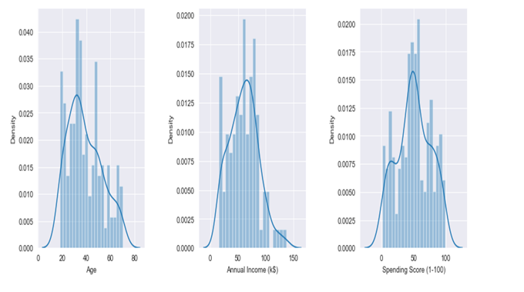
Displots of age, spending score and Annual income

Slide 23
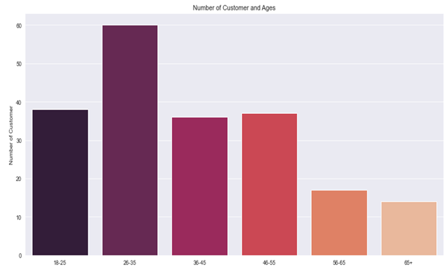
Bar plot b/w age vs No of customers

Slide 24
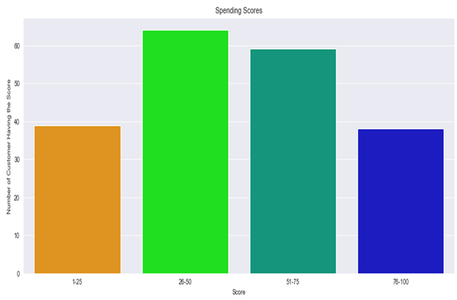
Bar plot b/w spending score vs no of customers

Slide 25
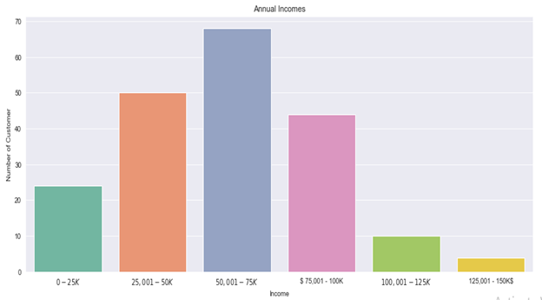
Bar plot b/w Income vs no of customers

Slide 26
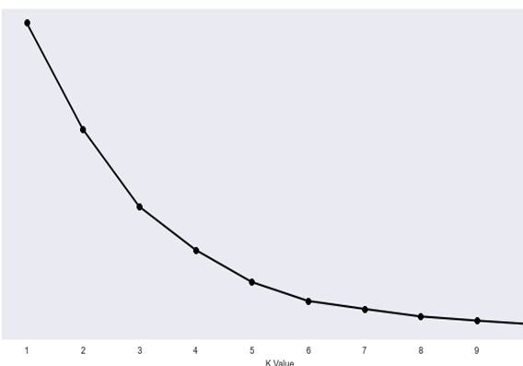
Elbow method to find no of clusters
Elbow method is a tool used for analysing the clusters formed from our dataset and helps to
interpret the appropriate number of optimal clusters in dataset. From this method the optimal
We get no of clusters as 5 from the graph as the value of wcss becomes almost constant after it

Slide 27
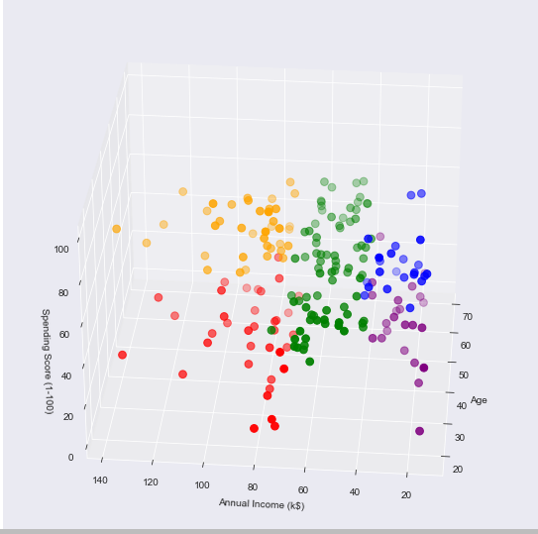
Output after implementing K – means on the dataset
After getting the no of clusters we implement K means algorithm and get the 3-d model of the clusters .
Blue - Cluster 1
Red - Cluster 2
Orange – Cluster 3
Purple - Cluster 4
Green - Cluster 5

Slide 28
Findings
Cluster 1 – Low income and high spending
Cluster 2 - High income and low spending
Cluster 3 – High Income and High Spending
Cluster 4 – Low income and low spending
Cluster 5 – Average Income and spending

Slide 29
Conclusion
From this data we can clearly see that people in cluster 3 are the most favorable and lot of companies and they will market heavily to this group of people as they are the ones who will be buying the expensive goods

Slide 30
Learning Outcomes
While doing this project I learnt a lot of important things that I was completely unaware of
1) What is Data Analysis and why is it so Important
In today's world .
2) what is customer segmentation and why is it
important
3) How machine learning helps with Customer
Segmentation
4) Practical Implementation of K-means Algorithm

Slide 31

This Photo by Unknown author is licensed under CC BY-NC.

